Slide 1
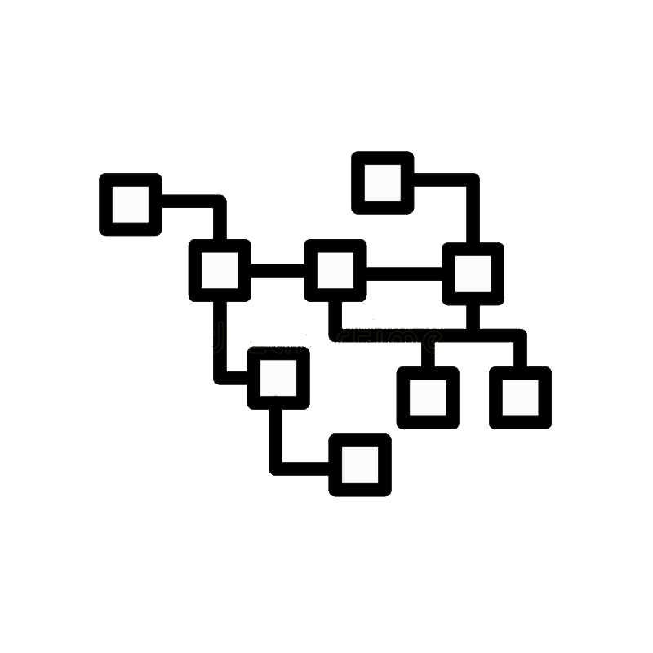
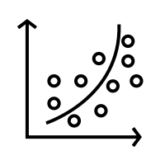
HERMIT: A Secondary Index
based on column correlations
Apostolos Papatheodorou

Slide 2
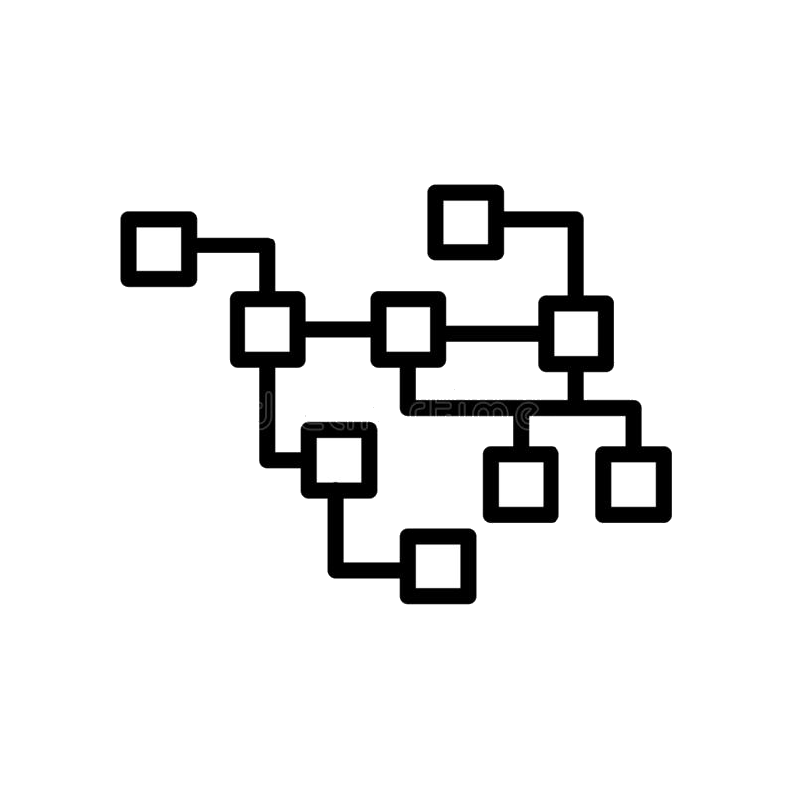
Presentation Structure
Definition of the problem
HERMIT
Lookup
Filtering
Construction
Maintenance
Evaluation
Let’s Start!

Slide 3


The Problem
The Problem
Secondary Indexes
are valuable for RDMSs performance.
How to construct them?
Detect the most frequent columns
Built!
If I need more?
Again!
freq.
freq.
freq.
Sec. Index
Sec. Index
Sec. Index

Slide 4



The Problem
The Problem
Secondary Indexes
are valuable for RDMSs performance.
How to construct them?
Detect the most frequent columns
Built!
What about memory…
what about maintenance...
freq.
freq.
freq.
Sec. Index
Sec. Index
Sec. Index

Slide 5
Existing Solutions
Suggestions
Drawbacks
Compression Techniques
Drop redundant information
save storage space
Compression decompression
Performance degradation
Limited space benefit
Learned or ML-INDEX
Exploit data distribution
Good performance
Space efficient
Training is time demanding
Heavy reorganization process
More: Column imprints,
Hippo, CM etc.

Slide 6

Existing Solutions
Targets
My proposal
HERMIT
Suggestions
Drawbacks
Compression Techniques
Drop redundant information
save storage space
Compression decompression
Performance degradation
Limited space benefit
Good Performance
Memory efficient
Easy to maintain
Scalable
Learned or ML-INDEX
Exploit data distribution
Good performance
Space efficient
Training is time demanding
Heavy reorganization process
More: Column imprints,
Hippo, CM etc.

Slide 7
HERMIT Overview
What all these things mean ???
Tiered Regression Search Tree: The most important part of HERMIT
Capture correlations between attributes M and N.
Handles outliers.
Decompose the curve fitting problem into subproblems
Correlation complexity determines the internal (Adaptive)
Reorganization ability (Dynamic)
Let’s see some Examples

Slide 8
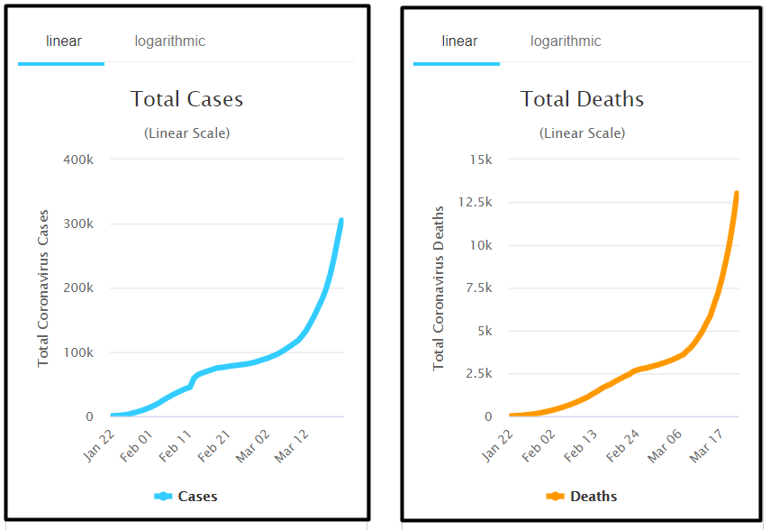
HERMIT Overview
Coronavirus Example
What all these things mean ???
Tiered Regression Search Tree: The most important part of HERMIT
Capture correlations between attributes M and N.
Handles outliers.
Decompose the curve fitting problem into subproblems
Correlation complexity determines the internal (Adaptive)
Reorganization ability (Dynamic)
COVID-19
Total Cases per Date
Total Deaths per Date
Linear correlation
Between them
Let’s see some Examples

Slide 9
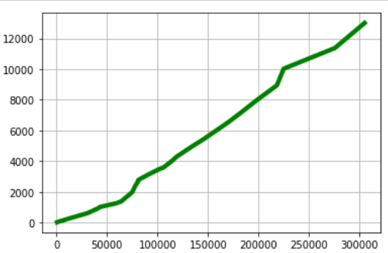
HERMIT Overview
Coronavirus Example
What all these things mean ???
Tiered Regression Search Tree: The most important part of HERMIT
Capture correlations between attributes M and N.
Handles outliers.
Decompose the curve fitting problem into subproblems
Correlation complexity determines the internal (Adaptive)
Reorganization ability (Dynamic)
COVID-19
Total Cases per Date
Total Deaths per Date
Linear correlation
Between them
Pearson corr: 0.913
Spearman corr: 9.90
Let’s see some Examples

Slide 10
HERMIT: Lookup
Suppose columns Dates, Cases, Fatalities
If Index(Cases) → Index(Fatalities)
If Index(Dates,X) → Index(Dates,Y)

Slide 11

HERMIT: Lookup
TRS TREE
Suppose columns Dates, Cases, Fatalities
If Index(Cases) → Index(Fatalities)
If Index(Dates,X) → Index(Dates,Y)
TRS-Tree Capture correlation between cases & Fatalities
y1=a*x1+b+(-e)
y2=a*x2+b+(+e)
From [x1,x2] → [y1,y2]=
[a*x1+b -e, a*x2+ b +e]
Input
[x1 x2 ]
Output
[y1 y2 ]
TRS Tree
Sec. Index
RESULTS

Slide 12
HERMIT: Lookup
TRS TREE
Suppose columns Dates, Cases, Fatalities
If Index(Cases) → Index(Fatalities)
If Index(Dates,X) → Index(Dates,Y)
TRS-Tree Capture correlation between cases & Fatalities
What is Filter ???
How do we choose epsilon ???
y1=a*x1+b+(-e)
y2=a*x2+b+(+e)
From [x1,x2] → [y1,y2]=
[a*x1+b -e, a*x2+ b +e]
Input
[x1 x2 ]
Output
[y1 y2 ]
TRS Tree
Sec. Index
RESULTS

Slide 13
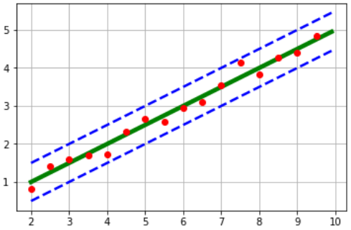
epsilon & Filter
Red Dots the records on database.
Blue lines: y1=a*x1+b -e & y2=a*x2+b +e
Point Lookup for x’=6:

Slide 14
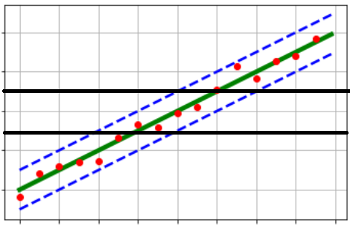
epsilon & Filter
Red Dots the records on database.
Blue lines: y1=a*x1+b -e & y2=a*x2+b +e
Point Lookup for x’=6:
[x’,x’] → [ax’+b-e, ax’+b-e] =[y1’, y2’]
Returns 4 values: FILTER them OUT
Keep only [x,y]=[6,y] (y belongs [y1’, y2’] )
y2’
y1’
x’=6
Error bound: The number of False positives (FP)
Suppose there are n points in database.
YES
We want based on our tolerance (error_bound ) to estimate the value of e.
Can we do this ???

Slide 15



epsilon & Error_bound
Red Dots the records on database.
Blue lines: y1=a*x1+b -e & y2=a*x2+b +e
Point Lookup for x’=6:
[x’,x’] → [ax’+b-e, ax’+b-e] =[y1’, y2’]
Returns 4 values: FILTER them OUT
Keep only [x,y]=[6,y] (y belongs [y1’, y2’] )
y2’
y1’
x’=6
erB =
Error bound: The number of False positives (FP)
Suppose there are n points in database.
Mathematically
e =
e =

Slide 16
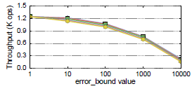
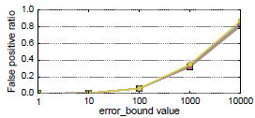
epsilon & Error_bound
Error_bound affect the performance only for low selectivity.
The bigger the query range the smaller the impact
It can be interpreted as injected noise (Default value=2)
Selectivity=0.01%
Performance drop drastically with increases of error_bound
Selectivity=0.01%
False positives reaches the 80% for total values for erB=10.000

Slide 17
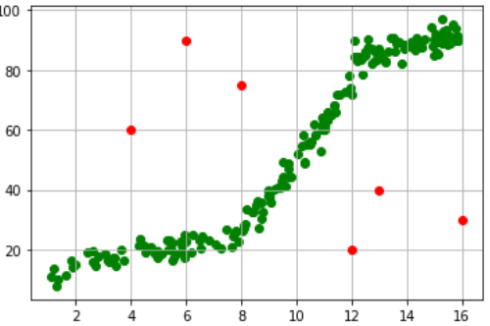

HERMIT: Construction
Coffee
TRS Tree is a graph which:
Capture correlations between attributes X and Y (ice-cream, coffee)
Every node of the graph correspond to a certain domain/range of X.
For a specific range [X1, X2] finds a Linear Regression line y=ax+b
Buffer for outliers (i.e. pairs of [x,y] which are not comply with the regressor)
ice-cream
TRS Tree
[1 - 16]

Slide 18
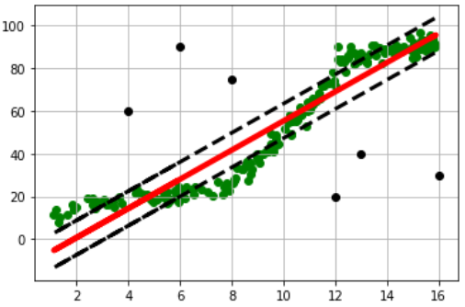

HERMIT: Construction
Coffee
TRS Tree is a graph which:
Capture correlations between attributes X and Y (ice-cream, coffee)
Every node of the graph correspond to a certain domain/range of X.
For a specific range [X1, X2] finds a Linear Regression line y=ax+b
Buffer for outliers (i.e. pairs of [x,y] which are not comply with the regressor)
TOO MUCH OUTLIERS
ice-cream
TRS Tree
[1 - 16]

Slide 19
HERMIT: Construction
Coffee
TRS Tree is a graph which:
Capture correlations between attributes X and Y (ice-cream, coffee)
Every node of the graph correspond to a certain domain/range of X.
For a specific range [X1, X2] finds a Linear Regression line y=ax+b
Buffer for outliers (i.e. pairs of [x,y] which are not comply with the regressor)
Split !!!
Fanout=2
ice-cream
TRS Tree
[1 - 16]

Slide 20
HERMIT: Construction
Coffee
TRS Tree is a graph which:
Capture correlations between attributes X and Y (ice-cream, coffee)
Every node of the graph correspond to a certain domain/range of X.
For a specific range [X1, X2] finds a Linear Regression line y=ax+b
Buffer for outliers (i.e. pairs of [x,y] which are not comply with the regressor)
ice-cream
TRS Tree
[1 - 16]

Slide 21
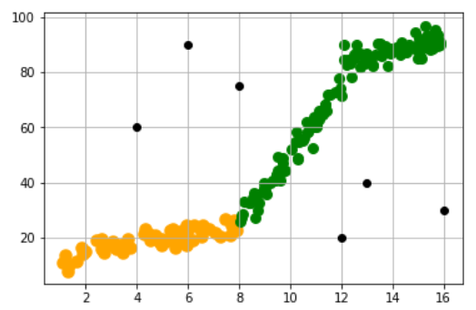
HERMIT: Construction
Coffee
TRS Tree is a graph which:
Capture correlations between attributes X and Y (ice-cream, coffee)
Every node of the graph correspond to a certain domain/range of X.
For a specific range [X1, X2] finds a Linear Regression line y=ax+b
Buffer for outliers (i.e. pairs of [x,y] which are not comply with the regressor)
Stop here for the left side.
On the right continue splitting
ice-cream
[1 - 8]
[8 - 16]

Slide 22
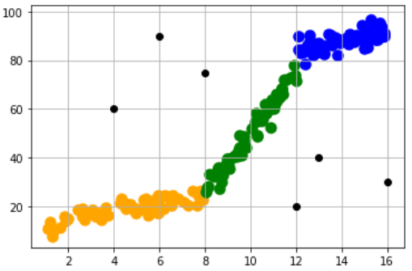
HERMIT: Construction
TRS Tree is a graph which:
Capture correlations between attributes X and Y (ice-cream, coffee)
Every node of the graph correspond to a certain domain/range of X.
For a specific range [X1, X2] finds a Linear Regression line y=ax+b
Buffer for outliers (i.e. pairs of [x,y] which are not comply with the regressor)
[1 - 8]
[8 -12]
[12-16]

Slide 23
HERMIT: Construction
TRS Tree is a graph which:
Capture correlations between attributes X and Y (ice-cream, coffee)
Every node of the graph correspond to a certain domain/range of X.
For a specific range [X1, X2] finds a Linear Regression line y=ax+b
Buffer for outliers (i.e. pairs of [x,y] which are not comply with the regressor)
Cost: Worst Case scenario
At every layer estimate a,b = O(N)
Repeat until the Maximum Height(h) of Tree O(hN)
h=Constant
Cost=o(N) Linear
[1 - 8]
[8 -12]
[12-16]

Slide 24
HERMIT: Construction
TRS Tree is a graph which:
Capture correlations between attributes X and Y (ice-cream, coffee)
Every node of the graph correspond to a certain domain/range of X.
For a specific range [X1, X2] finds a Linear Regression line y=ax+b
Buffer for outliers (i.e. pairs of [x,y] which are not comply with the regressor)
Insert(Delete)
New Tuple => New pair [ x’,y’ ]
GoTo Leaf node covers [x’]
IF a*x’+b-e < y < a*x’+b+e Break
Else Add(Remove) x’ in the outlier bucket
Cost: Worst Case scenario
At every layer estimate a,b = O(N)
Repeat until the Maximum Height(h) of Tree O(hN)
h=Constant
Cost=o(N) Linear
[1 - 8]
[8 -12]
[12-16]

Slide 25
HERMIT: Construction
TRS Tree is a graph which:
Capture correlations between attributes X and Y (ice-cream, coffee)
Every node of the graph correspond to a certain domain/range of X.
For a specific range [X1, X2] finds a Linear Regression line y=ax+b
Buffer for outliers (i.e. pairs of [x,y] which are not comply with the regressor)
Insert(Delete)
New Tuple => New pair [ x’,y’ ]
GoTo Leaf node covers [x’]
IF a*x’+b-e < y < a*x’+b+e Break
Else Add(Remove) x’ in the outlier bucket
Reorganization
It occurs Dynamically on background
Cost: Worst Case scenario
At every layer estimate a,b = O(N)
Repeat until the Maximum Height(h) of Tree O(hN)
h=Constant
Cost=o(N) Linear
[1 - 8]
[8 -12]
[12-16]

Slide 26
HERMIT: Summary
Capitalize column correlations
Limited space consumption
High competitive performance for range queries
Extremely functional (inserts, deletes, and updates)
Open to optimizations

Slide 27
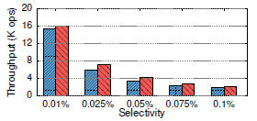
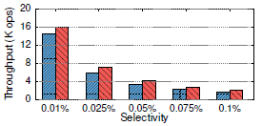
Evaluation Lookup Performance
Small selectivity means greater probability to extract False positives(FP). So the index has to check for and discard all these values. This lead to deterioration of lookup performance.
However FP influence declines disproportionately with selectivity.
HERMIT performance for Linear correlation function.
The performance is very close as TRS-Tree consist of only one Leaf.
HERMIT Lookup performance with Sigmoid correlation function.
Performance remain competitive as selectivity gros.

Slide 28
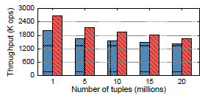
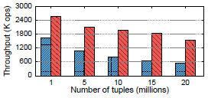
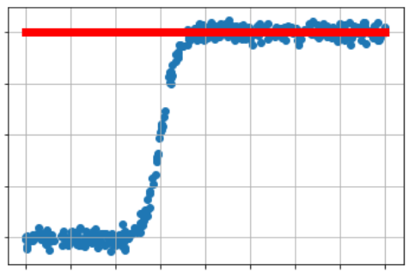
Evaluation Lookup Performance
Examine the Point Lookup Performance of HERMIT by increasing the number of tuples.
Linear
Sigmoid
For Sigmoid correlation the increasing number of records impedes HERMIT model the correlation.
Hence the overall number of false positives increases
Consequently the validation time (filtering) on base table expanded as well.
This leads to constant deterioration of LookUp performance

Slide 29
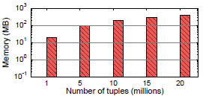
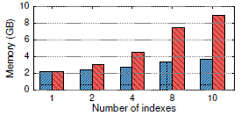
Evaluation Memory Consumption
For Linear correlation HERMIT needs only a constant amount of memory (few bytes).
No matter how many tuples exist in DB the size of index remain the same.
New B+Tree increase linearly the amount of memory consumption
For 10 Indexes are required 8.5 GB when HERMIT demand only 2.4 gB

Slide 30
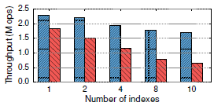
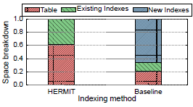
Evaluation Insertion throughput
HERMIT support Insert, Delete and update functions as it only cost is to update the leaf nodes.
For 10 indexes HERMIT can process 1.7M insert operations/sec
i.e. 2.6 times higher than the conventional secondary index
For B+ Tree 80% spends for inserting tuples into the secondary Indexes.

Slide 31

Questions ?
Thanks for watching

Slide 32



Appendix: Correlations
Attributes in relations are often correlated.
Correlation among columns imply high similarity in their index structure
So it is possible to approximate the values of different Columns
Can be utilized in Multi-column correlations (W,X)->(Y,Z) (seldom)
More Specifically: If M, N correlated attributes then
Close solution => Linear complexity

